Slide 1

Project Manager
Ali Alkhaiyat
STEM Display B Team 15
Secretary & Client Contact
David Rankin
Budget Liaison
Carlos Shields
Website Developer
Kevin Park
[1]
Notes:
Good evening
We are the wonder factory STEM display B Team 15
Ali Alkhaiyat: project manager
David Rankin: Secretary & client contact
Carlos Shields: Budget Liaison
Kevin Park:Website Developer

Slide 2
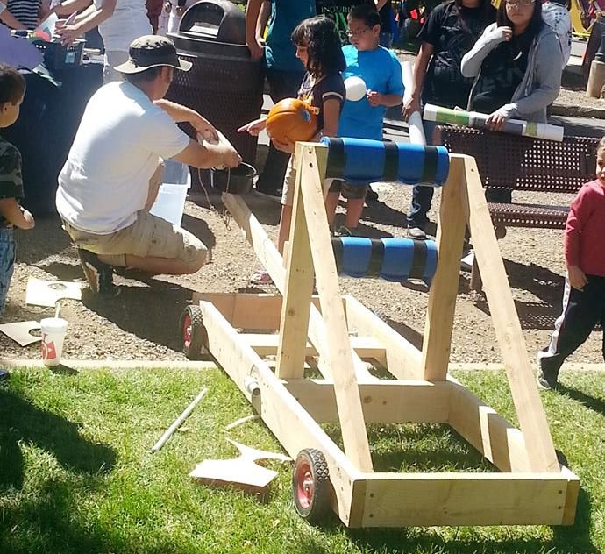
Project Description
The Wonder Factory
Interactive learning center
Goal
Generate learning through play
Location
Flagstaff, AZ
[1]
Ali Alkhaiyat 3/8/2017 The Wonder Factory STEM Display B - Team 15
Notes:
What is the Wonder Factory?
The Wonder Factory is the interactive science, technology, engineering, art and math (STEM/STEAM) in Flagstaff, AZ
The Wonder Factory was founded by two people who they are Jackee and Steve Alston
The Wonder Factory goal is to lead the next generation of young minds into their place as the thinkers, the makers, and the creators of the future through hands-on interactions with science, technology, engineering, art, and mathematics.

Slide 3
Project Description
- Must be safe to all users per applicable safety standards. Safety is our first priority!!
- Must be ready upon completion of this capstone sequence
- Should test the interactive display in a similar setting to expected everyday use
- Must interact with the clients in order to maintain parity with their expectations
Ali Alkhaiyat 3/8/2017 The Wonder Factory STEM Display B - Team 15
Notes:
The major goals for our project are listed below:
must be safe to all users
must be ready
must select, design, build and test one final unique idea
use critical thinking to solve a problem
use formal methods of teaching and make more fun for children
Project Expectations
The design stays as it is and we did not change it.

Slide 4
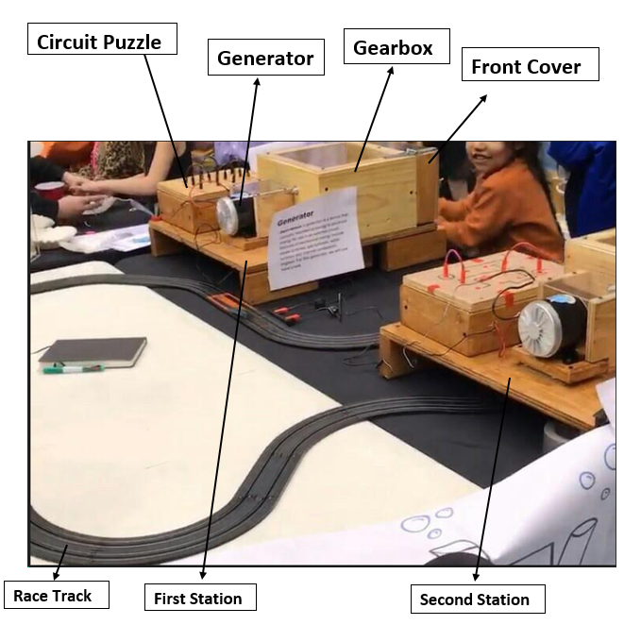
Project Description
Current Manufactured Design
Ali Alkhaiyat 3/8/2017 The Wonder Factory STEM Display B - Team 15
Notes:
The current design of The Wonder Factory Team 15 was manufactured:
The first and second station are included the Gearbox, Generator Circuit Puzzle and Race Track. The gearbox is connected with a DC generator and the DC generator
is connected with circuit puzzle. The circuit puzzle is connected with the Race Track to power the race track.The front cover can be opened and closed. The user is allowed to remove and put two sent of gears. Also, there is green wire rope that is placed on a hook. The green wire rope is connected with a steel pipe under the bottom plate.There is a compressed spring attached on the steel pipe. This steel pipe is able to be pushed down while the wire rope is on the hook.This safety mechanism is to lock the shaft while the front cover is open because there is no force pushed on the green wire rope when the cover is open.

Slide 5
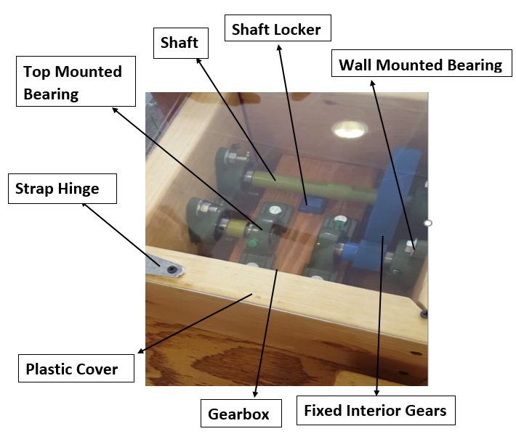
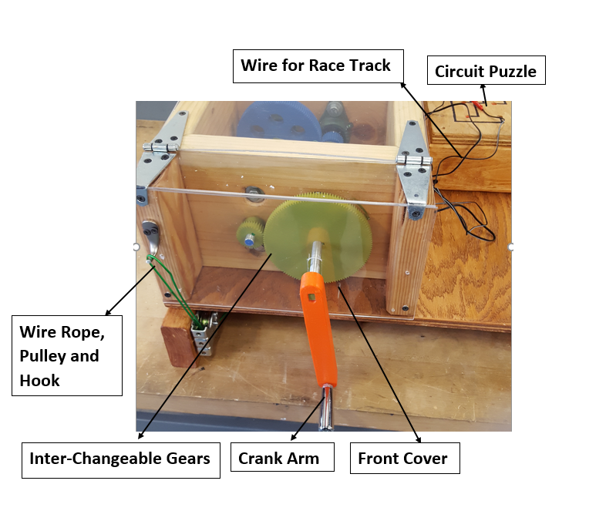
Project Description
Current Manufactured Design
Ali Alkhaiyat 3/8/2017 The Wonder Factory STEM Display B - Team 15​
Notes:
The gearbox has many parts inside.There are the two fixed gears conceded with two shafts. The third shaft is connected with crank arm. There are top mounted bearing and wall mounted bearing for the shafts. Also, there is the shaft locker for the shaft.This metal piece inside is a safety technique to lock the shaft when the front cover is open.The front cover can be opened to allow the user to remove and put two set of gears inside.

Slide 6
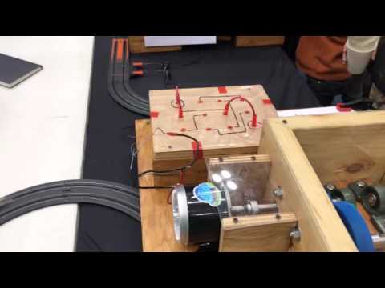
Here is a video from the Flagstaff STEM Celebration event our team attended along with The Wonder Factory. The event was held on Monday, March 6, at NAU's Skydome​
​
​
Notes:
https://www.youtube.com/watch?v=dzTyP4BdK0A

Slide 7
Updates
What we have done
Two stations
Safety mechanism
The way to cut wood
Adjust shaft distance
What we need to do
Make the stations up to four
Trim outlook (cover, cables)
Looking for steps or lower table
Lower gear ratio
Instruction with pictures
Kevin Park 3/8/2017 The Wonder Factory STEM Display B - Team 15
Notes:
What is left in the manufacturing of the design?
-we need to make it up to 4 stations

Slide 8
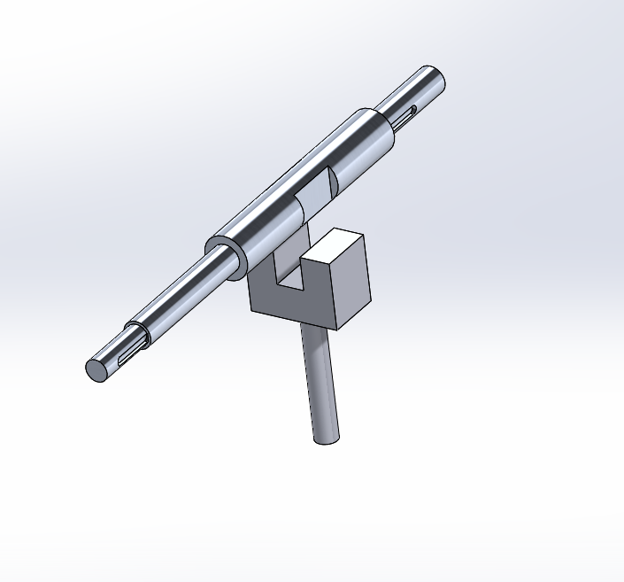
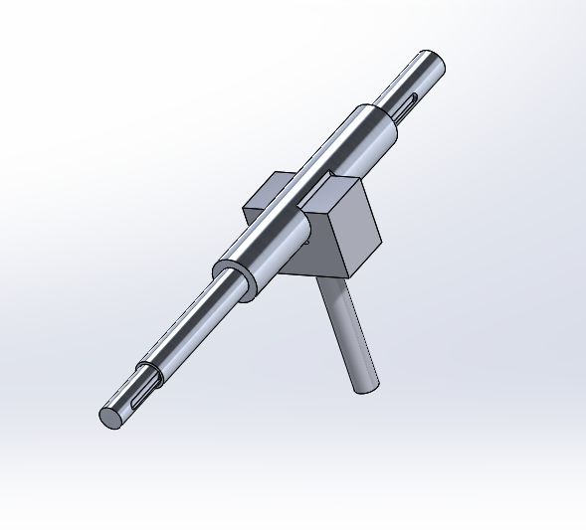
Updates
Safety mechanism
Kevin Park 3/8/2017 The Wonder Factory STEM Display B - Team 15
Notes:
Update the audience to what has been accomplished since the last presentation.
- safety mechanism & from the last presentation,we have been preparing stem night. As a result,we made 2 section of our project. (show video for this)
Where there any changes to the design? What caused those changes?
-we have been thinking about safety factor that putting something between gears. However, this would work only one way. Thus,we changed safety factor holding intermediate shaft looks like it.

Slide 9
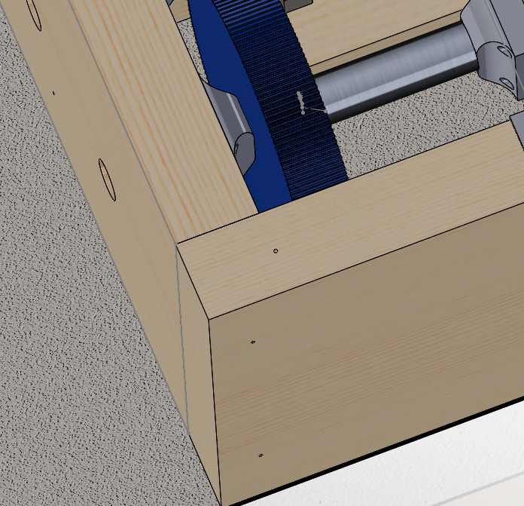
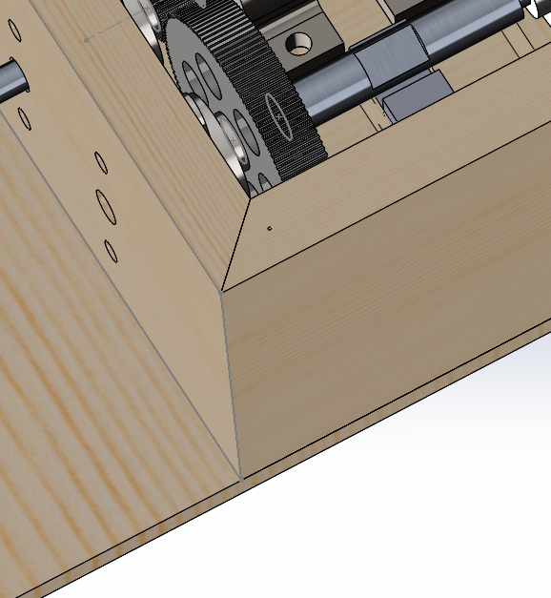
Updates
Wood cut
Kevin Park 3/8/2017 The Wonder Factory STEM Display B - Team 15
Notes:
Where there any changes to the design? What caused those changes?
-in addition, we changed the way to cut edge where facing each part of wood.
-shaft distance(space and efficiency)

Slide 10
Updates
What we need to do (DOE)
Make the stations up to four
Trim outlook (cover, cables)
Lower table or steps
Lower gear ratio
Instruction with pictures
Simple race track
Kevin Park 3/8/2017 The Wonder Factory STEM Display B - Team 15
Notes:
What is left in the manufacturing of the design?
-we need to make it up to 4 stations

Slide 11
Moving Forward
Testing
Reduce power output
Current limiter or resistor
Front cover and crank arm
New gear ratios and wider front gears without hub
Contingencies
Request funds from client
Fundraising
Reduce amount of stations
David Rankin 3/8/2017 The Wonder Factory STEM Display B - Team 15
Notes:
We have already conducted numerous testing. For example, we have already tested the generator for power output, the 3D printed gears for viability, and the circuit puzzle. We had the opportunity to have our client and their children test our design for ease-of-use and overall operation. We also took several notes during the STEM celebration event while people of all ages tested both stations. From that event, we found that we will need to somehow reduce the power output of the generator. We plan to do this by adding a current reducing element to the circuit puzzle and lowering the front gear ratios. We plan to also conduct more testing on the front cover and crank arm so it is able to open more smoothly and reduce pinch points. We also plan to remove the hub form the front gears and just make them one inch wide instead of half an inch wide. This is due to the fact that many kids at the even did not understand the concept of making the hubs face the same direction.
Some of our contingencies if we go over budget is to first request additional funds from our client since we have been given permission from them to do so. If that does not work, we plan to do some fundraising until we reach meet our budget. The final contingency is to reduce the amount of stations from four to three or even two.

Slide 12
Moving Forward: Manufacturing Plan and Responsibilities
Ali
Cut, sand, and stain all wooden pieces
Install safety mech. and assemble stations
Conduct inspection of each station for operation, safety, and quality
Assist UGRADS poster and op./assem. manual
David
Manufacture shaft, safety mech., and crank arm
Order and test different gear ratios
Assemble and inspect each station for safety
Create UGRADS poster and op./assem. manual
Add logo and inspect overall visual aesthetics
Carlos
Conduct tests of circuit puzzle operation and install final electronics
Finalize all wiring for all electronics
Confirm budget and request more funds
Assist with info posters and instructions
Kevin
Assist with electronic wiring and installation
Assist with wood sanding and staining
Install top, front, and generator cover
Update SolidWorks files and website
Create station info posters and instructions
David Rankin 3/8/2017 The Wonder Factory STEM Display B - Team 15
Notes:
Here is our final manufacturing plan with designated responsibilities. Ali plans to cut, sand, and stain all wooden parts as well as install the safety mechanism. He will also be in charge of the final assembly and assist with the UGRADS poster and the operation and assembly manual.
Carlos will be responsible for ensuring the output current will be reduced through the electronic circuit puzzle and install all electronic devices. He will also finalize the budget and create a additional funds proposal, if necessary.
I will ensure that the additional six shafts, two safety mechanisms, and four crank arms are manufactured by either doing the manufacturing myself or submitting work orders. I will order the new gears for the current stations and all of the gears for the additional two stations. I will also be responsible for the UGRADS poster and operation/assembly manual along with the final quality control inspection of all stations.
Kevin will assist Carlos with the final electronics installation and Ali with the wood manufacturing. He will be responsible for adding all covers and ensuring all SolidWorks files and the website stay current. Kevin and Carlos will also be in charge of creating the station informational posters and instructions.

Slide 13
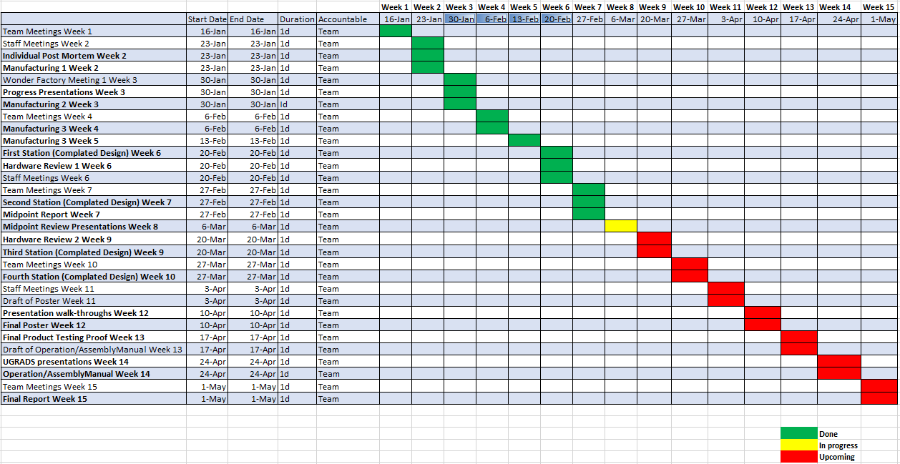
Schedule - Gantt Chart
Juan Carlos Shields 3/8/2017 The Wonder Factory STEM Display B - Team 15
Notes:
So far we are on schedule. We have been able to meet class requirements and dates easily. We were able to have 2 stations working on march 6th for the Flagstaff STEM event. We plan on making another 2 in the 2 weeks after spring break and to use the data provided from the event and the hardware review to make improvements on all 4.

Slide 14

Budget
$2,000
Spent so far: 1624.57
Extra funding approved
Projected Spending: 2071.71
Projected Balance: $-71.71
Juan Carlos Shields 3/8/2017 The Wonder Factory STEM Display B - Team 15
Notes:
Our budget is still $2000 and we have spent a little more money from the last time The projected spending has increased because of changes that were addressed in the hardware review. Jackey and Steve have told us many time that they are willing to give us extra funds if we need them so we may need to rely on those if we aren't able to cover the deficit.

Slide 15
QUESTIONS?
THANK YOU!
3/8/2017 The Wonder Factory STEM Display B - Team 15

Slide 16
References
[1] The Wonder Factory [Online]. Available: www.facebook.com/thewonderfactoryflagstaff

